Slide 1
Lecture 3
Topics:
Compound Propositions
Tautology and Contradictions
Logical Equivalence

Slide 2

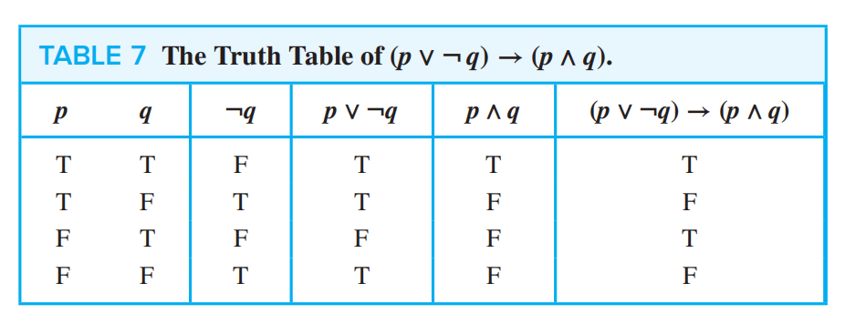

Slide 3
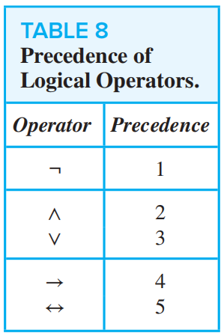
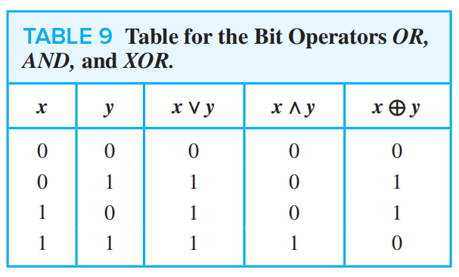

Slide 4



Slide 5




Slide 6


Slide 7


Slide 8
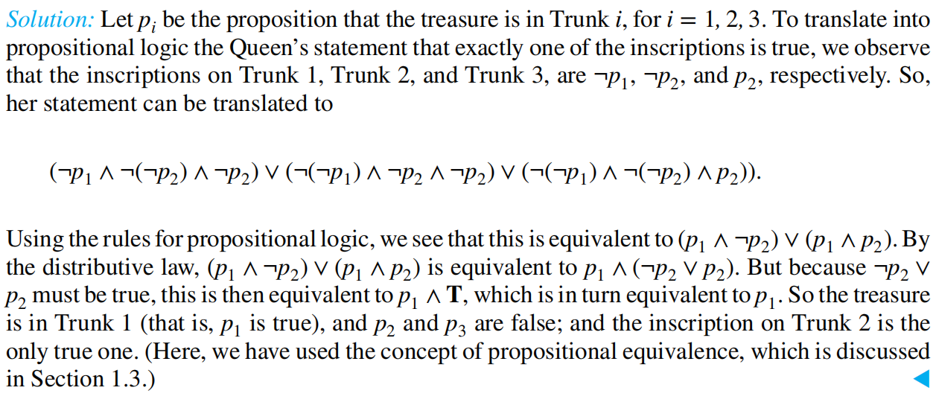

Slide 9


Slide 10


Slide 11

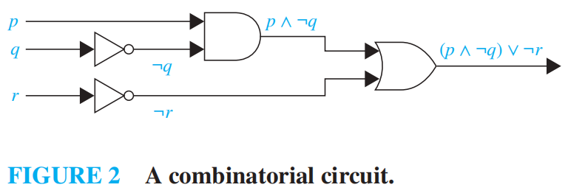

Slide 12


Slide 13
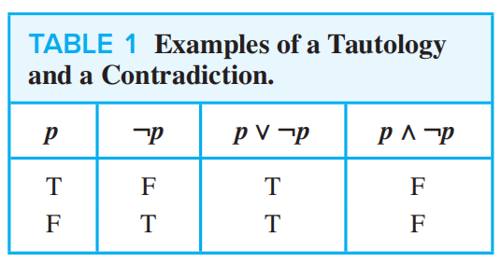

Slide 14

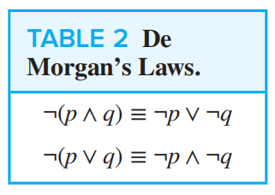

Slide 15
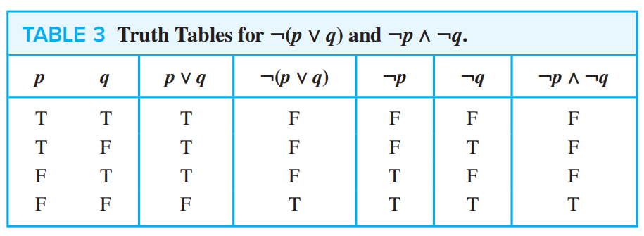

Slide 16
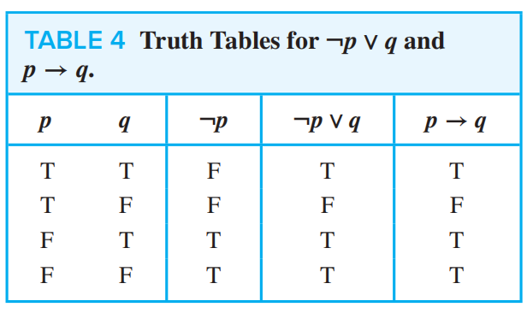

Slide 17
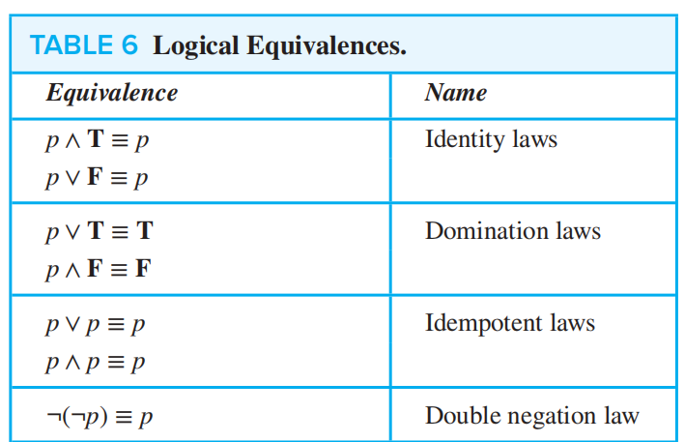

Slide 18
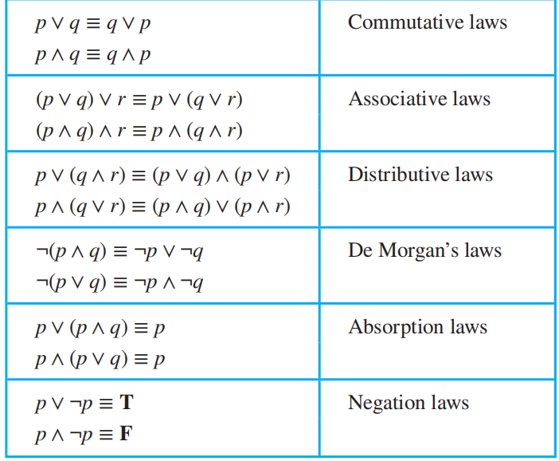

Slide 19
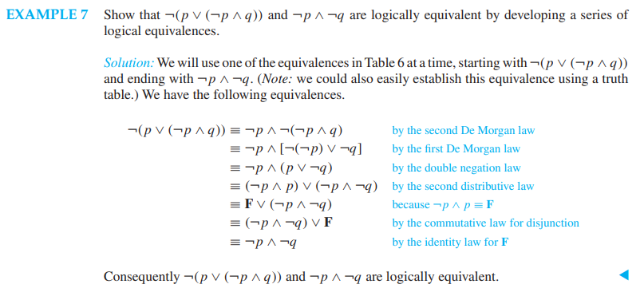
Development using Series of Logical Equivalences

Slide 20
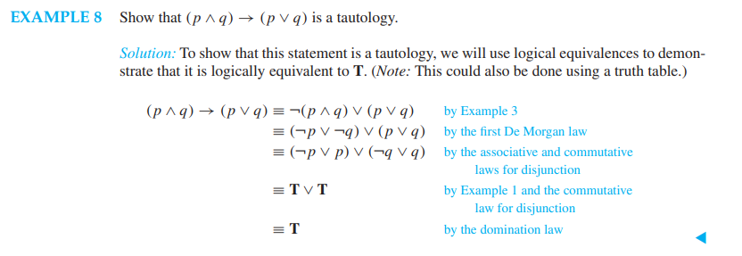
Development using Series of Logical Equivalences (2)
The following logical equivalence is used for Example 8:
p → q ≡ ¬p ∨ q

Slide 21


Slide 22




